Slide 1

Sales Performance Dashboard
This repository contains a case study analysis of sales data, along with a dashboard created to visualize the findings. The data encompasses various dimensions including customer demographics, product details, and sales metrics. This README file provides an overview of the data, the analysis performed, Key insights and Recommendations.

Slide 2

Table of Contents
Overview
Data Columns
Analysis Performed
Dashboard
Key insights
Recommendations

Slide 3

Overview
The primary goal of this project was to analyze sales data to derive insights into customer behavior, product performance, and sales trends. The resulting dashboard enables stakeholders to interactively explore the data and gain valuable insights for strategic decision-making.

Slide 4
Data Columns
The dataset used in this project includes the following columns:
Date:
The date of the transaction.
Year:
The year of the transaction.
Month:
The month of the transaction.
Customer:
The identifier of the customer.
Sales Person:
The sales person responsible for the transaction.
Customer Age:
The age of the customer.
Customer Age Group:
The age group category of the customer.
Customer Gender:
The gender of the customer.
State:
The state where the transaction occurred.
Product Category:
The category of the product sold.
Sub_CategoryThe sub-category of the product sold.
Payment Option:
The payment option used by the customer.
Quantity:
The quantity of the product sold.
Unit Cost:
The unit cost of the product.
Unit Price:
The unit price of the product.
Total Cost
: The total cost of the transaction.
Total Revenue: The total revenue generated from the transaction.
Profit/Loss:
The profit or loss from the transaction.

Slide 5

Analysis Performed
The analysis performed in this project includes:
Trends and Seasonality Analysis: Identifying Monthly and Yearly Trends as well as Seasonal Patterns.
Customer Analysis: Age, gender, and geographical distribution of customers.
Sales Performance: Revenue, cost, and profit/loss analysis over time.
Product Analysis: Performance of different product categories and sub-categories.
Sales Person Performance: Analysis of sales performance by different sales persons.
Payment Options: Trends in payment options used by customers.

Slide 6
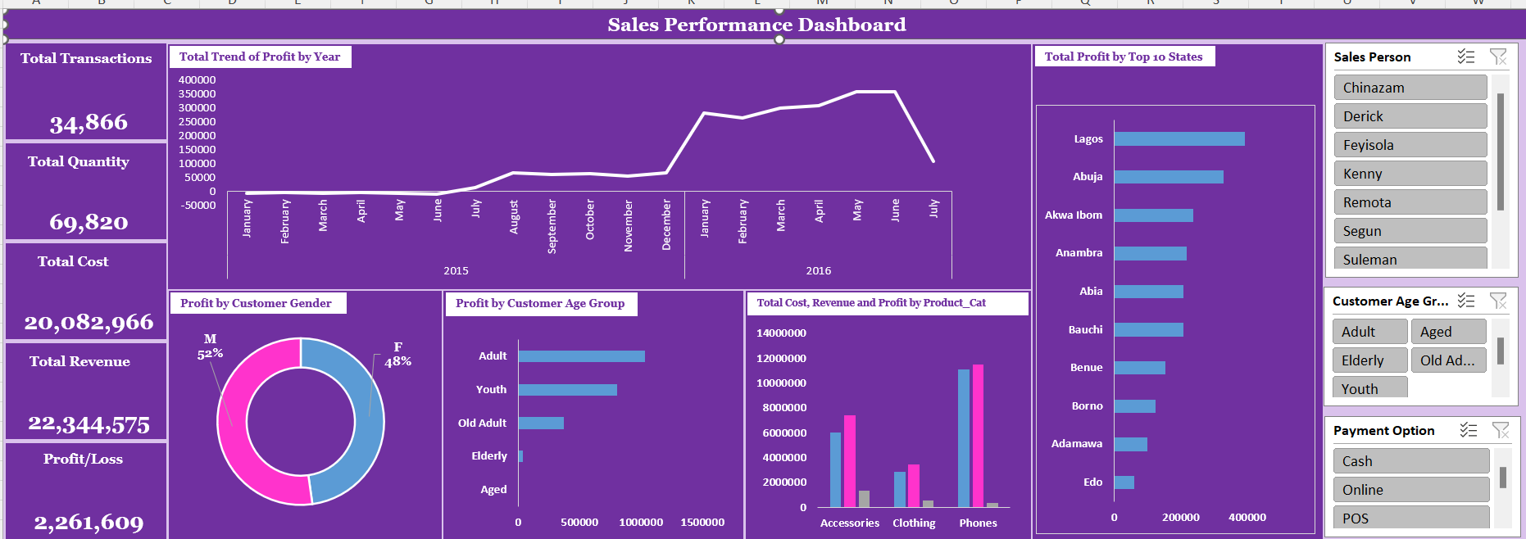
DASHBOARD

Slide 7
KEY INSIGHTS
There are notable peaks in December and a decline in July
Adults contribute the most to profit, while the profit distribution is fairly balanced between genders.
Phones generate the highest total cost and revenue, while accessories generate the highest profit.
Cash payment emerged as the most preferred method of payment

Slide 8
RECOMMENDATIONS
Create targeted marketing campaigns for Adults and Youths, tailor marketing campaigns to appeal to both male and female customers.
Focus on states with the highest profits for marketing efforts, inventory stocking, and promotional activities. Analyze factors contributing to lower performance in other states and strategize on ways to improve sales there.
Given that phones generate the highest total cost and revenue, while accessories generate the highest profit, I recommend focusing on maintaining strong sales in the phone category due to its substantial revenue contribution, while simultaneously increasing marketing efforts and inventory for accessories to maximize their higher profit margins. This dual approach ensures steady revenue streams from high-demand phones and boosts overall profitability by leveraging the higher margins from accessories.

